Slide 1
research estonia
Name

Slide 2
northern europe’s hub for knowledge and digital business
Finland
Sweden
Estonia
Russia
Latvia
Lithuania
Poland
population: 1.3 million
area: 45,339 km2
currency: Euro
member of: EU, Eurozone, OECD,
NATO and Schengen
Europe

Slide 3
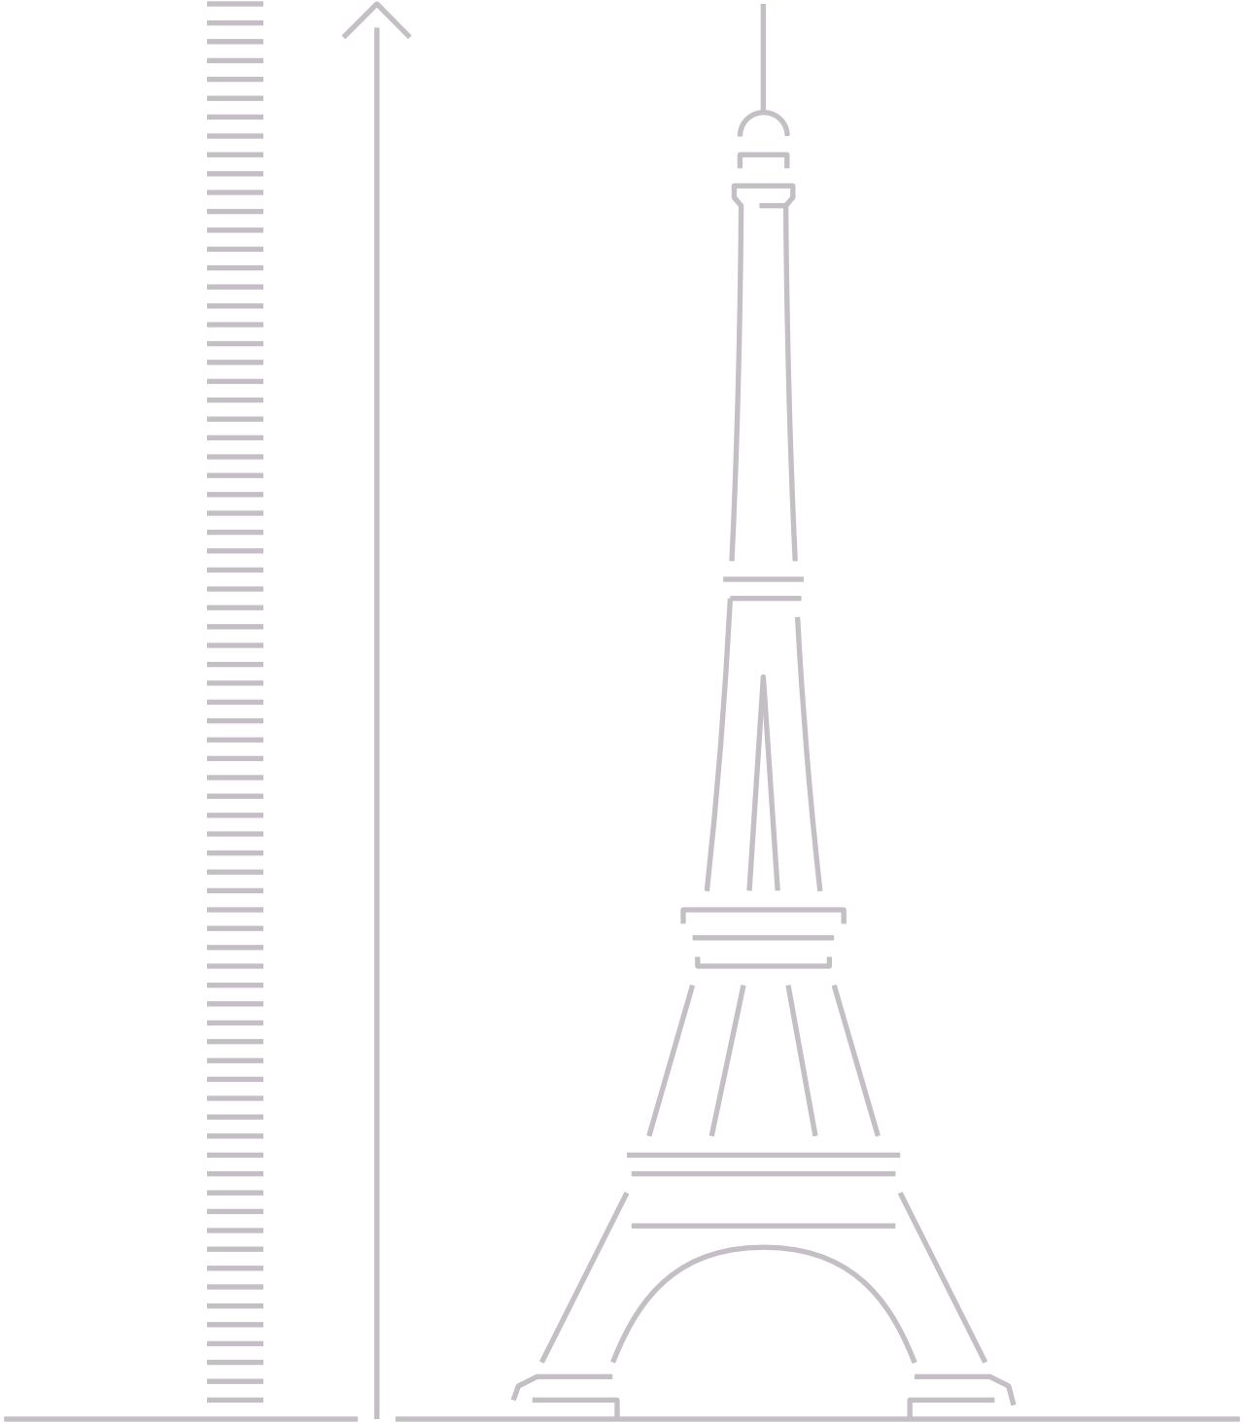

we are a digital society
300
meters
99% state services are online
digital signature saves 5 days a year
e-Residency
A stack of paper saved each month
Notes:
Estonia is the world’s first country to also function as a digital service. Our unique approach is to offer a variety of state services to people outside of Estonia. Register a company online, digitally sign and exchange encrypted documents, conduct secure online bank transfers, and make tax declarations electronically. In 2005, Estonia became the first nation in history to offer internet voting in a nationwide election.
Estonia is the first country to offer e-Residency, a government-issued digital ID available to anyone in the world. E-Residency offers the freedom to easily start and run a global business in a trusted EU environment. Since 2014 more than 33,000 people have applied for e-residency and established more than 5000 companies.

Slide 4
information society indicators
Entire country is covered with a broadband connection
98% of the population has an ID-card
98% of companies established online
1st country to use blockchain on national level
99% of banking done online
30% of the population uses i-Voting
Notes:
3G and 4G coverage over almost the entire country
Estonia, together with Sweden, will already be the first countries in Europe with 5G mobile internet in 2018
Nearly every one of Estonia's 1.3 million citizens has an ID card, which is a mandatory national card with a chip that carries embedded files and can function as definitive proof of ID in an electronic environment. The ID card applies to the highest EU standards and provides citizens with digital access to all of Estonia’s secure e-services, releasing them from bureaucracy and making daily tasks faster and more comfortable, whether we are talking about banking or business operations, signing documents or obtaining a digital medical prescription.
All the data exchanges, M2M communications, data at rest, and log files are independently and fully accountable thanks to KSI Blockchain technology. With KSI Blockchain deployed in Estonian government networks, history cannot be rewritten by anybody and the authenticity of the electronic data can be mathematically proven. It means that no-one – not hackers, not system administrators, and not even the government itself – can manipulate the data and get away with it.
A few hours to start a company:
Time to establish a business cut down from 5 days to 18 minutes - it has been a world record for years (today Oman is #1, but with help from Estonian IT companies). That’s exactly why 99% of people prefer establishing their companies online. With 99.8% of all banking transactions made online, running a company in Estonia is easy.

Slide 5

international rankings
#1
#2
#1
OECD Tax Competitiveness Index
2017
Index of Economic Freedom in EU (7th in the World)
The Heritage Foundation 2018
Internet Freedom
Freedom House
2017
#1
#12
#9
Entrepreneurial Activity
World Economic Forum
2017
Ease of Doing Business World Bank
2018
Digital Economy and
Society Index
European Commission 2017

Slide 6

#3 in Europe in the number of start-ups per capita
© Transferwise
Notes:
According to the World Economic Forum, Estonia is the most entrepreneurial country in Europe. World-changing start-ups originate from Estonia: TransferWise, GrabCAD, Fortumo, Pipedrive, Starship Technologies, and Skype.

Slide 7
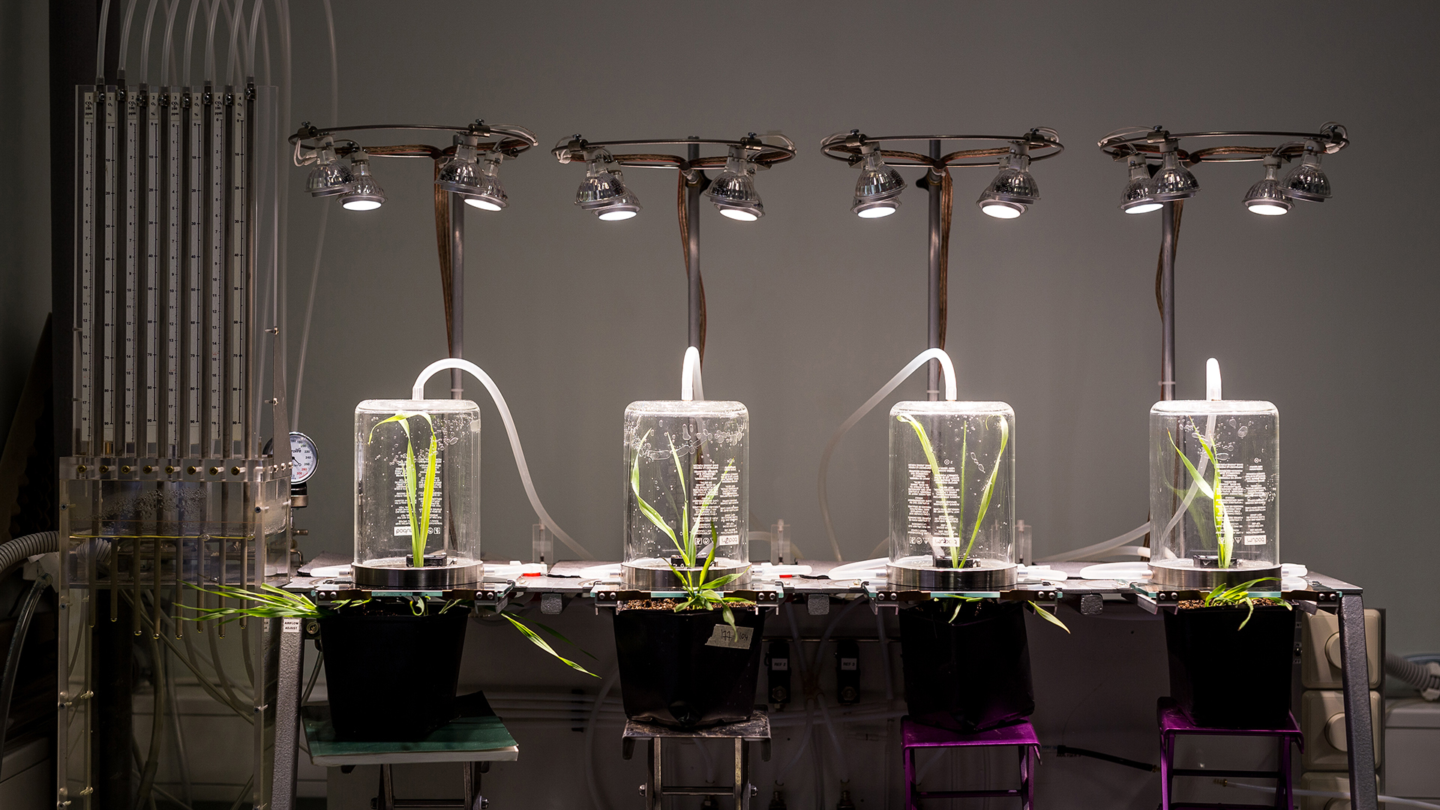
research & innovation
© Renee Altrov

Slide 8
broad, innovative and diverse
6,72
researchers
per thousand employment
FTE (2015)
excellent conditions
for carrying out research projects
highly qualified
staff at the
research institutes
6x growth
in the number of international researchers employed in Estonia since 2005
Notes:
Estonia has a broad, innovative and diverse research landscape. Research is primarily carried out by universities and other public and private sector education and research institutions. Currently, the third Research and Development and Innovation Strategy 2014-2020 “Knowledge-based Estonia” is being implemented. Strategy focuses mainly on achieving top level and versatile research activities, and implementing the created potential for improving the development of Estonia and making its economic structure more research-intensive.

Slide 9
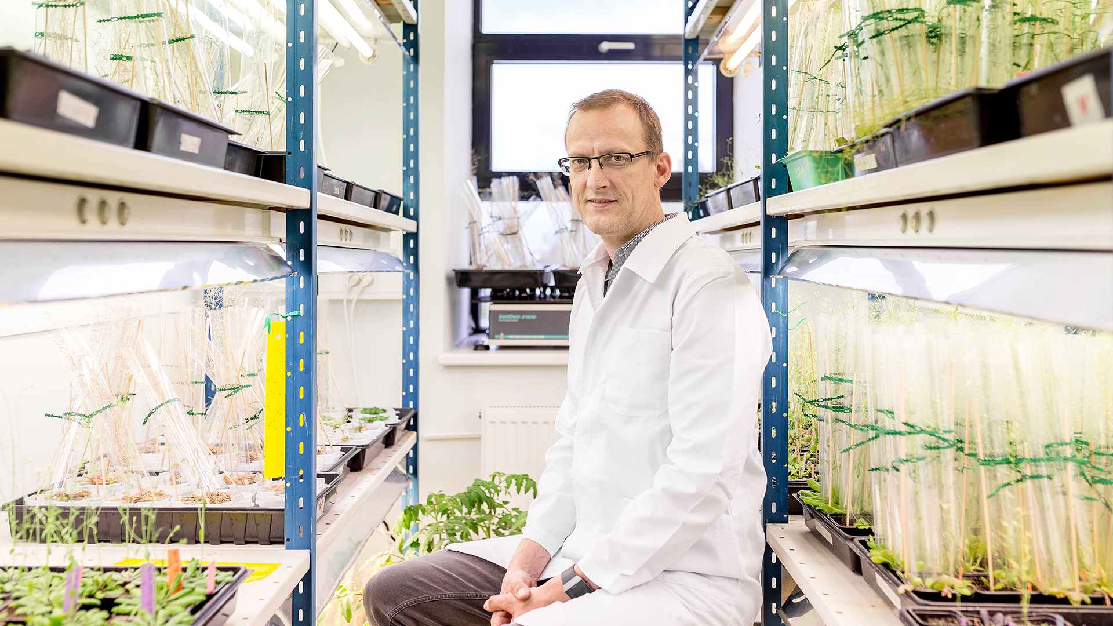
3200 researchers per million
© Renee Altrov
Notes:
Estonia stands close to European Union mid-level with its 3200 researchers in R&D per million people. Compared to other Baltic countries Estonia is clearly distinguishable, having around 1/3 more researchers working in the field of R&D. Since 2005 the number of international researchers employed in Estonia has multiplied by six.

Slide 10
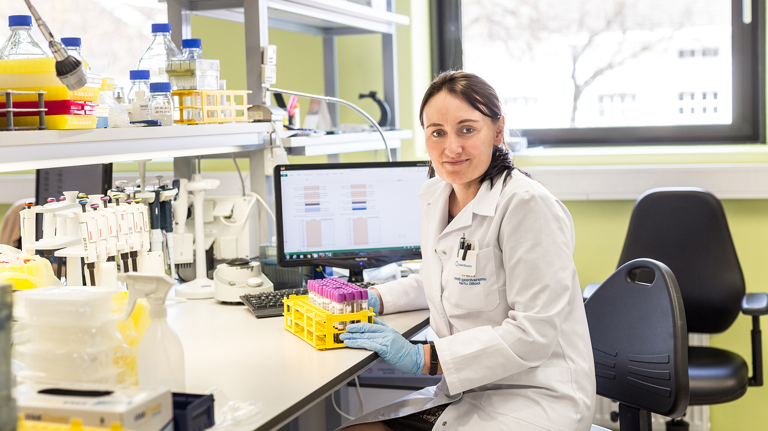
excellent conditions
© Renee Altrov
Notes:
Estonia offers excellent conditions for carrying out research projects with highly qualified colleagues and staff at the universities and other research institutes and in industry.

Slide 11
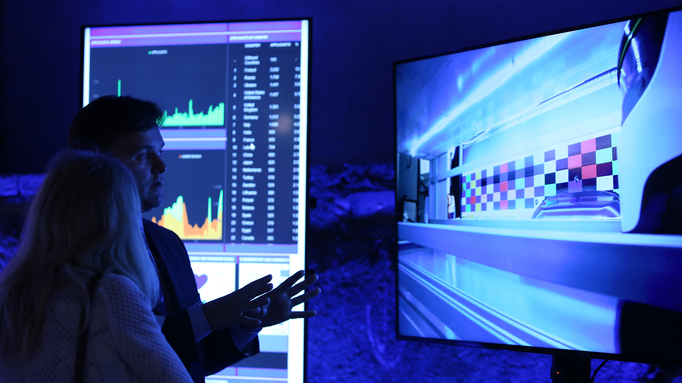
science for business
© Annika Haas
Notes:
Solutions for global problems are sought through the development of science and technology and they are applied ever increasingly in cooperation between the public and private sectors.

Slide 12
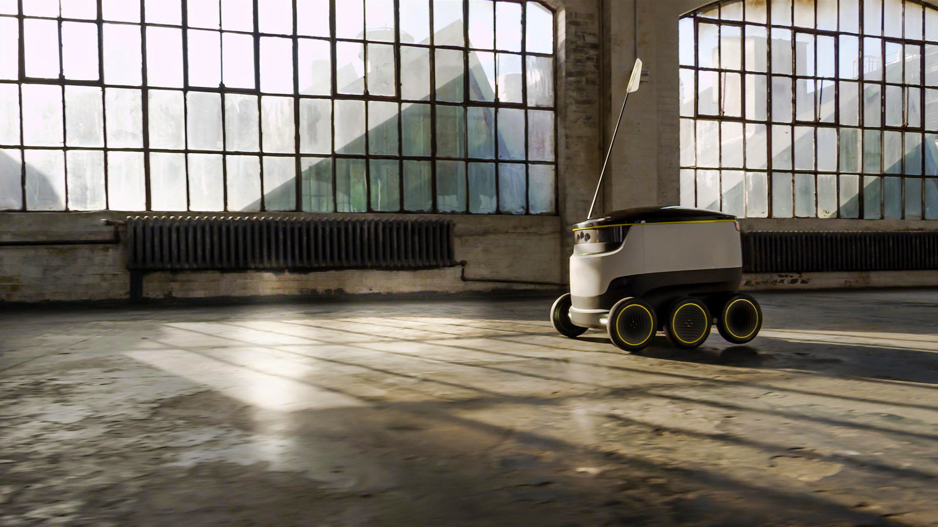
Starship Technologies
© Starship Technologies
Notes:
For example Starship Technologies in cooperation with Tallinn University of Technology develops a package delivery robot, which has been tested in more than hundred cities all over the world

Slide 13
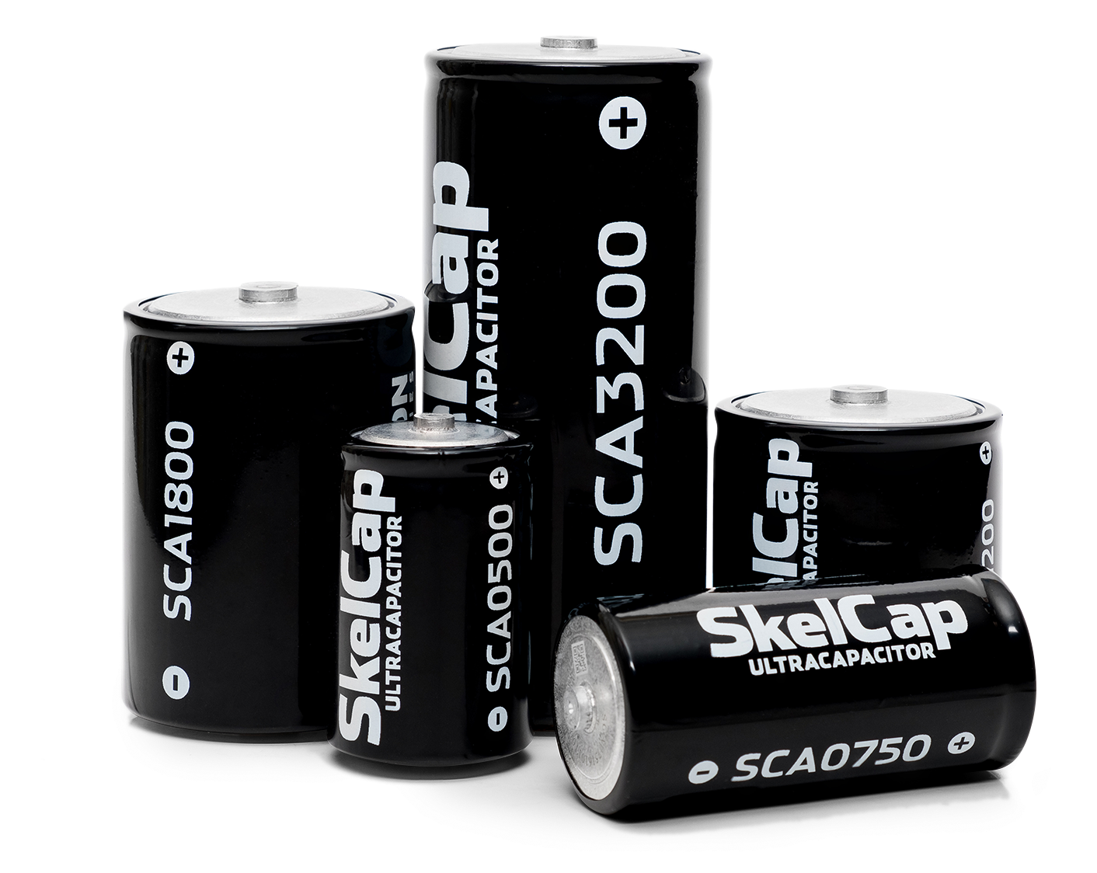
Skeleton Technologies
© Skeleton Technologies
Notes:
Global Cleantech 100 club member and European Space Agency's supplier Skeleton Technologies is European market leader in ultracapacitor-based energy storage that was created by University of Tartu scientists.

Slide 14
scientific publications and citations
Notes:
The high quality of Estonian research and researchers is also visible in research output.

Slide 15
10 most cited fields
Source: WoS (InCites) in 2006-2016.
clinical
medicine
physics
plant and animal sciences
microbiology
biology and biochemistry
2.
4.
6.
8.
10.
1.
3.
5.
7.
9.
molecular biology and genetics
pharmacology and toxicology
psychiatry and psychology
environmental sciences and ecology
space science
Notes:
The most cited fields (compared to global average of the field) according to WoS are environmental sciences and ecology, plant and animal sciences, clinical medicine, molecular biology and genetics, physics, pharmacology and toxicology and psychiatry and psychology. Among recent notable discoveries are Estonian researchers Ülo Niinemets, who found that stressed plants emit a stress response, thus helping to create clouds, while researcher Tuul Sepp studied the colour of House Finch plumage, finding that birds with poor digestion basically loose their colour.

Slide 16
TOP 20 in the world
Source: OECD STI Scoreboard 2017
for the
publications published
this result
guarantees Estonia a place among the
in 2015
10,3%
TOP 20
by Estonian authors
Reached the
10% of the world’s most cited publications
in the world
Notes:
For the publications published in 2015 by Estonian authors, 10.3% reached the 10% of the world`s most cited publications. This result guarantees Estonia a place among the top twenty in the world.

Slide 17

one of the world`s best-educated country
© Tõnu Runnel

Slide 18
overview
1st
3rd
9th
85%
in OECD's PISA tests
in Europe
in the world in science skills (OECD's PISA tests)
in the world in math skills (OECD's PISA tests)
of schools
use e-School
LIFELONG LEARNING STRATEGY WITH ICT
Notes:
According to OECD PISA test results in 2015 Estonian students were Europeans best performing in science, reading and mathematics, while they also belong to the TOP3 of the world following Singapore and Japan.

Slide 19
tertiary educational attainment
Estonia
age group 30-34 2005-2016
European
Union
average
increased
in Estonia
14%
45,4%
39,1%
Notes:
Between 2005-2016 tertiary educational attainment in the age group 30-34 increased in Estonia around 14%, with its 45,4% it is higher than European Union average 39,1%.

Slide 20
growth in doctoral degree defenders
international
doctoral students
14%
PhD students
in Estonia in 2017
Notes:
Within 20 years (1995-2015) there has been impressive sevenfold growth in the number of doctoral degree defenders. The country is also growingly attractive for foreign students: between 2006-2017 the number increased more than four times, while the number of international doctoral students has grown more than five times and their relative importance is 14% from all PhD students in Estonia. During 2011-2016 the biggest growth of foreign students has been from Africa, which has increased 14 times while the number of Asian students has tripled.

Slide 21
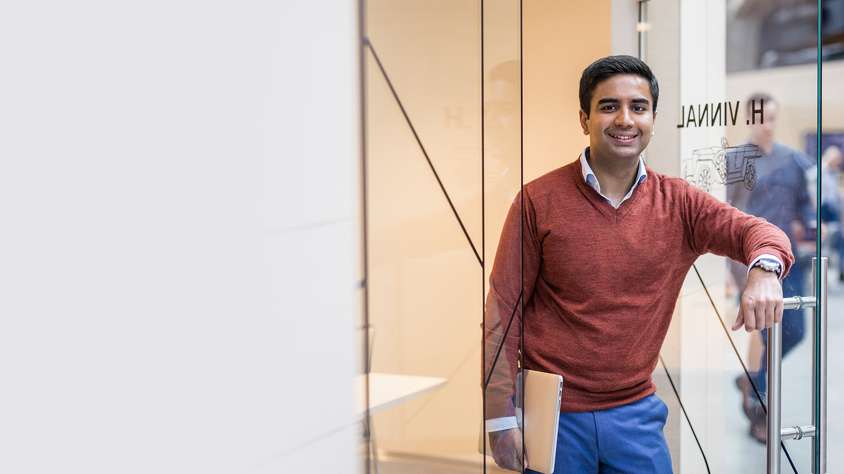
international research cooperation
© Renee Altrov

Slide 22


active partners
European
Organization for Nuclear Research (CERN)
European
Space Agency
European
Social Survey
European
Spallation Source
Notes:
More than 2/3 of the publications by Estonian researchers have been published in collaboration with foreign colleagues. Being highly valued partners in the international cooperation projects when theory goes to practice they are actively participating in European Organization for Nuclear Research (CERN), European Space Agency, European Social Survey, European Spallation Source and other various science and R&D projects.

Slide 23
7-th framework programme
7-TH FRAMEWORK PROGRAMME
465 projects
88 000 000 €
EXAMPLES
U-CAT or Underwater Curious Archaeology Turtle robot, developed by Biorobotics Centre of Tallinn University of Technology
Mars house
prototype SHEE, developed by University of Tartu with International Space University
Nanosatellite
ESTCube-1,
coordinated by Tartu Observatory and University of Tartu
Notes:
Since 2007-2014 EU-s 7-th Framework Programme had 540 participants from Estonia, who received 88 million euros contribution from EU. Remarkable projects were:
U-CAT or Underwater Curious Archaeology Turtle robot, project led by Biorobotics Center of Tallinn University of Technology. Widely acknowledged is also student built nanosatellite ESTCube-1 that was coordinated by Tartu Observatory and University of Tartu, whereas ESTCube-2 is an Estonian satellite slated for launch in 2019, its primary objectives are to test a "plasma brake" for deorbiting satellites and to test electric sail propulsion technology. University of Tartu is also partner in developing Mars house prototype SHEE or Self-deployable Habitat for Extreme Environments with International Space University.

Slide 24
Horizon 2020
HORIZON 2020
252 projects
92 000 000 €
EXAMPLES
Novel glioblastoma targeted therapy and a companion diagnostic compound, developed by University of Tartu, Cancerlab
Data-driven decision making for a more efficient society, coordinated by SME Cybernetica
SmartEndCity-
Towards Smart
Zero CO₂ Cities
across Europe,
Participated by City of Tartu
Notes:
Since 2014 306 Horizon 2020 participants have received 82 million euros from EU, whereas 91 SME-s have been funded with 26 million euros.
The European Research Council is funding brain cancer studies at Lab of Cancer Biology at University of Tartu, while SME AS Cybernetica has a grant for researching data-driven decision making for a more efficient society and City of Tartu is participant in the H2020 project “Towards Smart Zero CO2 Cities across Europe”.

Slide 25
funding

Slide 26
financed based on quality
Expenses on R&D by
sources 2016 (mld eur)
research giants
38,4
14%
business enterprise sector
130,42
48%
baseline
funding
13,9
5%
foreign
capital
36,61
14%
101,61
37%
other
government funding
49,31
18%
0,77
0,28%
universities and high schools
0,94
0,34%
private non-profit sector
Notes:
Research in Estonia is primarily financed on the basis of quality competition. Financing comes mainly from the state budget; but also form companies, foreign funds (mainly the EU’s Framework Programme for Research and Innovation Horizon 2020), and other EU initiatives. Estonian Research Council (ETAg) is the main body responsible for the funding of R&D, supports researchers’ mobility and external cooperation offering various segment of grants.

Slide 27
EU contribution
EU financial contribution for participants from a country in relation to GDP (EU28=100%)
350%
300%
250%
200%
150%
100%
50%
0%
Notes:
Research in Estonia is primarily financed on the basis of quality competition. Financing comes mainly from the state budget; but also form companies, foreign funds (mainly the EU’s Framework Programme for Research and Innovation Horizon 2020), and other EU initiatives. Estonian Research Council (ETAg) is the main body responsible for the funding of R&D, supports researchers’ mobility and external cooperation offering various segment of grants.

Slide 28
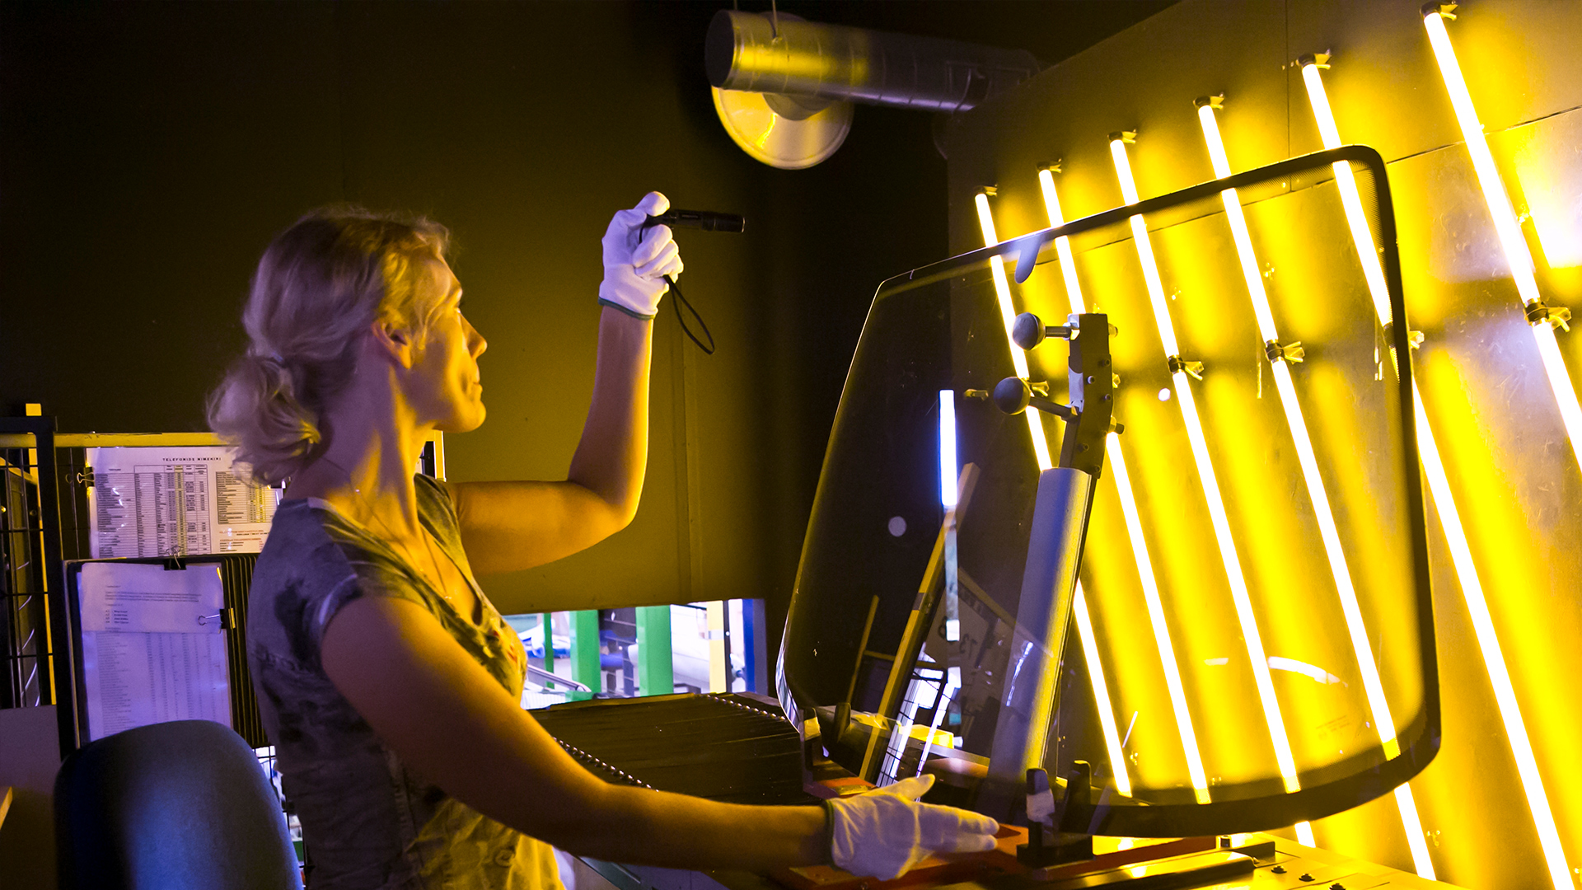
smart specialisation
© Annika Haas

Slide 29
focused on
ICT
HEALTH TECH
ICT
start-ups
cyber security
robotics
smart textiles
personal medicine
digital prescriptions
genetics research
e-Health
materials science and industry
innovative construction
healthy and functional food
chemical industry
Notes:
Whereas in science publication Estonia makes waves in environmental and natural sciences, the main focus of local RDI strategy is to boost the growth of three sectors: ICT horizontally through all sectors, health technologies and services, and effective use of resources.
IT sits at the core of how Estonia runs ― and portrays ― itself. From cybersecurity to biomimetic robots and smart textiles Estonian research has a lot to offer.
Estonia with its e-Health programme (incorporating Electronic Health Records, Digital Image, eAmbulance, e-Prescriptions etc) and Biobank stands out for its ongoing ambitions to develop and implement personal healthcare.
Effective use of resources focuses on materials science and industry, innovative construction (“smart house”), health promoting and functional food, and chemical industry (more effective use of oil shale).

Slide 30
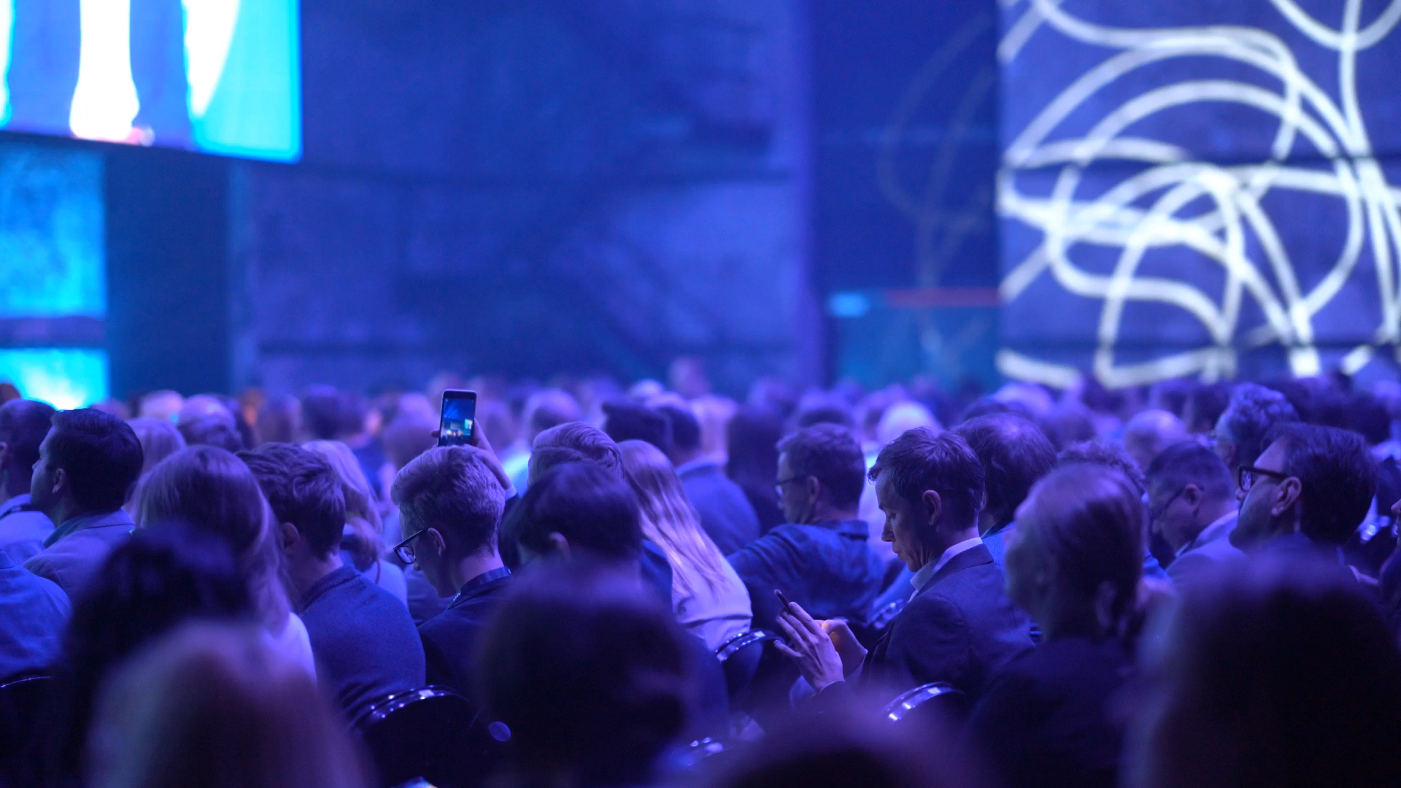
thank you!
© Virgo Haan

