Slide 1
research in estonia

Slide 2

northern Europe’s hub for knowledge and digital business
population: 1.3 million
area: 45,227 km2
currency: Euro
member of: EU, Eurozone, OECD,
NATO and Schengen

Slide 3
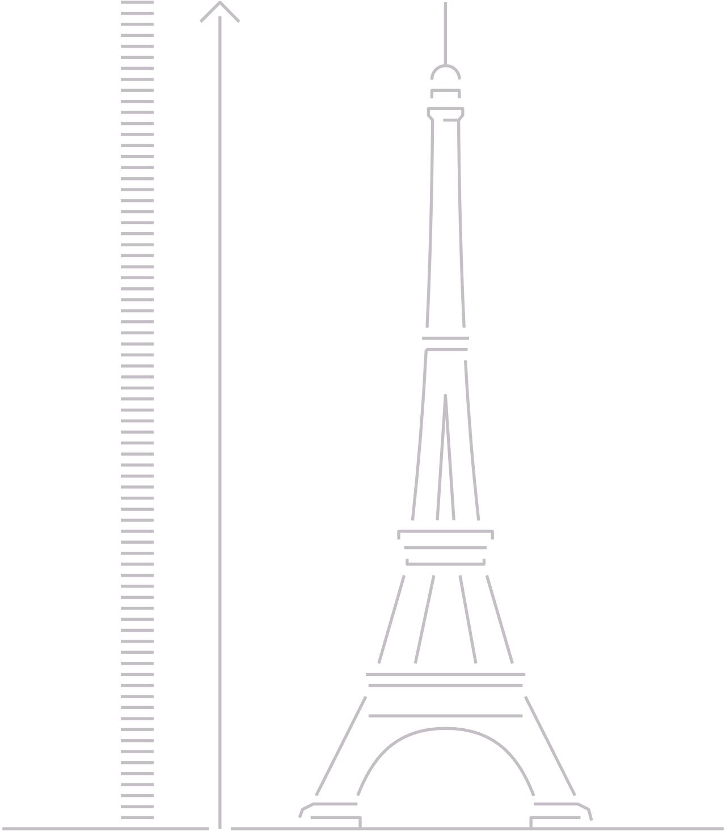

we are a digital society
300
meters
99% state services are online
digital signature saves 5 days a year
e-Residency
A stack of paper saved each month
Notes:
Estonia is the world’s first country to also function as a digital service. Our unique approach is to offer a variety of state services to people outside of Estonia. Register a company online, digitally sign and exchange encrypted documents, conduct secure online bank transfers, and make tax declarations electronically. In 2005, Estonia became the first nation in history to offer internet voting in a nationwide election.
In Estonia, the term “digital signature” (i.e. digi-signature, digital signing, etc.) refers only to a signature that is legally valid and legally equivalent to a handwritten signature. This means that the identity of the user and the background of the issuer of the certificate have been verified and that the time of issue of the signature is precisely fixed. To put it plainly, it has been identified who signed it and it is ensured that no third party has changed the document to be signed since it was signed (id.ee).
Estonia is the first country to offer e-Residency, a government-issued digital ID available to anyone in the world. E-Residency offers the freedom to easily start and run a global business in a trusted EU environment. Since 2014 more than 70,000+ people from 170+ countries have applied for e-residency and established more than 12,000+ Estonian companies. Learn more: https://learn.e-resident.gov.ee/hc/en-us/articles/360000711978-What-is-e-Residency

Slide 4
information society indicators
Entire country is covered with a broadband connection
99% of the population has an ID-card
98% of companies established online
1st country to use blockchain on national level
99% of banking done online
47% of the population uses i-Voting
Notes:
Broadband development in Estonia: Estonia updated the targets and measures for broadband as part of its Digital Agenda 2020 in early 2014. The strategy envisages full coverage with connections of at least 30 Mbps by 2020 and aims to promote take-up of ultra-fast subscriptions with at least 100 Mbps with the objective that these account for 60% or more of all internet subscriptions by the same year. Estonia is currently deploying a middle-mile network of fibre-optic cables. After completion, 98% of all residential buildings, companies, and public authorities will be located within 1.5 km of at least one fibre-optic network access point. Estonia’s new information society strategy is in preparation. With its 5G roadmap, Estonia would like to achieve 5G connectivity in major cities by 2023 and along transport corridors by 2025 (European Commission).
ID-card:
Nearly every one of Estonia's 1.3 million citizens has an ID card, which is a mandatory national card with a chip that carries embedded files and can function as definitive proof of ID in an electronic environment. The ID card applies to the highest EU standards and provides citizens with digital access to all of Estonia’s secure e-services, releasing them from bureaucracy and making daily tasks faster and more comfortable, whether we are talking about banking or business operations, signing documents or obtaining a digital medical prescription.
Every ID-card user has a personal e-mail address, issued by the Republic of Estonia. This address is meant as an official channel of communication between the state and the person.
Estonian citizens can use their ID-card to enter other European Union (EU) and European Economic Area (EEA) member states without a passport.
There are so many client cards and loyalty programmes this day and age that fitting all the cards in your wallet can be difficult. Using the ID-card as the client card is therefore a convenient alternative.
Companies: Estonia’s e-Business Register is an advanced and secure tool that allows entrepreneurs to register new business online in just minutes without having to go to a notary or some other official. From 2011, most companies have been established over the internet using the e‑Business Register and this process has come down from 5 days to couple of hours.
Blockchain: All the data exchanges, M2M communications, data at rest, and log files are independently and fully accountable thanks to KSI Blockchain technology. With KSI Blockchain deployed in Estonian government networks, history cannot be rewritten by anybody and the authenticity of the electronic data can be mathematically proven. It means that no-one – not hackers, not system administrators, and not even the government itself – can manipulate the data and get away with it. The KSI Blockchain technology was developed by Estonian computer scientists and led to the development of the Estonian e-state technologies as well as the products of two internationally successful Estonian companies, Cybernetica AS and Guardtime AS.
Banking: It is hard to overstate the enormous role Estonia’s banks have played in creating and promoting the nation’s e-government solutions. Banks not only wholeheartedly embraced e-ID, encouraging customers to use their ID cards for secure transactions, even giving away free card readers, they also helped move the population online by developing and offering high-quality internet banking services. Today, over 99% of all banking transactions in the country are carried out online.
You can access internet banking services anytime from anywhere in the world
You can do transactions online without visiting a bank
i-voting: it is a unique solution that simply and conveniently helps to engage people in the governance process. In 2005, Estonia became the first country in the world to hold nation-wide elections using this method, and in 2007, it made headlines as the first country to use i-Voting in parliamentary elections.
Learn more: e-estonia.com/solutions/ or id.ee/en

Slide 5

international rankings
#1
#1
#2
OECD Tax Competitiveness Index
2019
Digital Health Index
Bartelsmann Foundation
2019
Internet Freedom
Freedom House
2020
#1
#18
#2
Entrepreneurial Activity
World Economic Forum
2017
Ease of Doing Business World Bank
2019
Start-Up Friendliness
Index Venture 2021
Notes:
OECD Tax Competitiveness Index: For the sixth year in a row, Estonia has the best tax code in the OECD. Its top score is driven by four positive features of its tax code. First, it has a 20 percent tax rate on corporate income that is only applied to distributed profits. Second, it has a flat 20 percent tax on individual income that does not apply to personal dividend income. Third, its property tax applies only to the value of land, rather than to the value of real property or capital. Finally, it has a territorial tax system that exempts 100 percent of foreign profits earned by domestic corporations from domestic taxation, with few restrictions.
Learn more: https://taxfoundation.org/2019-international-index/
Digital Health Index: With its X-Road infrastructure, which enables secure data exchange between all actors in the healthcare system (and the entire public sector), Estonia is one of the most digitally advanced countries in Europe. In 2005, the Ministry of Social Affairs secured subsidies from EU structural funds to develop four eHealth projects:
the electronic health record (EHR)
digital imaging
digital registration
ePrescriptions
Today, all citizens in Estonia can view their examination results, medication plans or vaccination data online and they can also determine which physicians and other healthcare professionals have access to their information.
Learn more: https://www.bertelsmann-stiftung.de/en/our-projects/the-digital-patient/projektthemen/smarthealthsystems/
Internet freedom: Estonia has been ranked in second place in U.S. think tank Freedom House's global Internet freedom index and maintained its previously high score. The index covers areas, such as obstacles to access, lack of unfounded restrictions on online content, ensuring user rights, as well as the freedom and responsibilities of online user behaviour. The Estonian government places few limitations on internet access, fewer limitations on online content, and robust protections for user rights. This approach served Estonia well during the COVID-19 pandemic, as society was able to function with relatively little interruption by making use of digital public services.
Learn more: freedomhouse.org/country/estonia/freedom-net/2020
Entrepreneurial activity: According to the report, Europe’s Hidden Entrepreneurs: Entrepreneurial Employee Activity and Competitiveness in Europe, when you take both total early-stage entrepreneurial activity (TEA) and entrepreneurial employee activity (EEA) together, a picture emerges of highly entrepreneurial Baltic countries. In this ranking Estonia comes out on top, while two of Europe’s largest economies, Germany and France, don’t even make the top 10.
Estonia has a high rate of TEA and an above average rate of EEA. Almost 80% of businesses started in Estonia are opportunity-driven and Estonia is often cited as a model for entrepreneurially-oriented policy, says the report.
Learn more: weforum.org/agenda/2017/03/europes-most-entrepreneurial-country/
Ease of Doing Business: The Estonian legal environment favours entrepreneurship and an entrepreneurial mindset. Foreign investors have equal rights and obligations with local entrepreneurs. All foreign investors may establish a company and conduct business in Estonia in the same way as local investors – no restrictions apply.
Learn more: investinestonia.com/business-in-estonia/legal-system/doing-business/
See also the latest economy profile of Estonia (2020): doingbusiness.org/content/dam/doingBusiness/country/e/estonia/EST.pdf
Learn also about e-residency, which gives access to the EU business environment: https://e-estonia.com/solutions/e-identity/e-residency/
Start-Up Friendliness: Index Venture ranks Estonia the second most „startup friendly“ country in Europe. Index Ventures revised its country ranking based on the favourability of stock option policies, placing all three Baltic nations ahead of 22 other countries including the US, the UK, Israel, France and Germany.
Learn more: https://tech.eu/brief/baltic-startups-stock-policies/

Slide 6

#1 in Europe in the number of start-ups per capita
© Transferwise
Notes:
Estonia is the world leader in unicorns per capita. Despite a population of 1.3 million people, the country has been the birthplace of six unicorns so far: Skype in 2005, Playtech in 2007, Wise in 2015 (former name TransferWise), Bolt in 2018, Pipedrive in 2020 and Zego in 2021. That’s 4.6 unicorns per capita. And the time lag between the creation of each following unicorn is constantly decreasing (Invest in Estonia).

Slide 7

one of the world`s best-educated country
© Tõnu Runnel
Notes:
The skills of Estonian students rank 1st in Europe according to the OECD’s international survey PISA (Programme for International Student Assessment). Estonian students rank first in all three domains of assessment. The share of top performers has increased while the share of students performing below the baseline level has decreased. The results indicate that the level of education provided by basic school is not dependent on the socio-economic background of a student. (Republic of Estonia, Ministry of Education and Research)

Slide 8
overview
1st
4th
5th
in OECD's PISA tests
in Europe
in the world in science skills (OECD's PISA tests)
in the world in reading skills (OECD's PISA tests)
8th
100%
in the world in math skills (OECD's PISA tests)
of schools
use e-School
Notes:
PISA 2018 shows that Estonian students ranked first among European countries in all three domains of assessment. It also placed first in Reading (523 points) and Science (530 points) and third in Mathematics (523 points) among the OECD countries. Estonia ranks fifth in Reading, fourth in Science and eighth in Mathematics among all participating countries and economies.
PISA 2018 demonstrates that the improvement in Reading performance in particular was marked at the top of the distribution.
The share of top performers in Reading has increased from 6.1% in 2009 to 13.9% in 2018 (OECD mean 8.6%). At the same time, the number of students performing below the baseline level has decreased from 13.3% in 2009 to 11.1% in 2018 (OECD mean 22.5%).
PISA 2018 shows that the share of top performers in Mathematics has increased to 15.5% (OECD mean 10.9%). 89.9% of Estonian students have achieved the baseline level of proficiency in Mathematics.
Estonian students have shown stable and high results in Science in all PISA cycles. 8.8% of students have not reached the baseline level (OECD mean 22%) and 12.2% are top performers (OECD mean 6.8%).
Learn more: hm.ee/en/activities/statistics-and-analysis/pisa
100% use e-school: The two most widely used web applications for schools in Estonia are eKool and Stuudium. These innovative tools provide an easy way for parents, teachers and children to collaborate and organize all the information necessary for teaching and learning.
Learn more: https://e-estonia.com/solutions/education/e-school/

Slide 9
tertiary educational attainment
Estonia
age group 30-34 2012-2020
European
Union
average
increased
in Estonia
13%
40%
41,6%
Notes:
Between 2012-2020 tertiary educational attainment in the age group 30-34 increased in Estonia around 13%, with its 40% it is just a little under the European Union average, which is 41,6% (Estonian Statistics, 2020).
A relatively large share of tertiary students pursue a master’s level degree in Estonia, either through long first degrees or through a master’s following a bachelor’s. In 2017, about 31% of all tertiary students in the country were enrolled in a master’s level course, nearly double the OECD average of 16%. The share of tertiary students enrolled in doctoral programmes is also well above the OECD average (6% in Estonia compared to 2% on average across OECD countries). Between 2014 and 2018, the share of the population holding a doctorate in Estonia increased from 0.5% to 0.7% (OECD average: 1.1%). (OECD, 2019)
The most popular broad fields of study among tertiary graduates in Estonia are business, administration and law (23%) and engineering, manufacturing and construction (15%), both in line with the respective OECD averages (OECD, 2019).
Learn more: oecd.org/education/education-at-a-glance/EAG2019_CN_EST.pdf

Slide 10
increasingly attractive for international PhD students
international
PhD students
29%
PhD students in Estonia in 2020/2021
Notes:
The country is also growingly attractive for foreign students. Since the academic year 2016/2017 the number of foreign PhD students has been constantly rising. While in 2016/17 there were 375 foreign PhD students studying in Estonia, then in the academic year 2020/21 the number has risen to 672 students, making their relative importance 29% from all PhD students in Estonia. Alltogether are currently (2020/21) enrolled 2318 doctoral degree students. (The Education and Youth Board)
Within 20 years (2001-2020) there has been impressive fourfold growth (3,55) in the number of doctoral degree defenders. During the 2019/20 academic year there were 121 different nationalities studying in Estonian institutions of higher education.

Slide 11
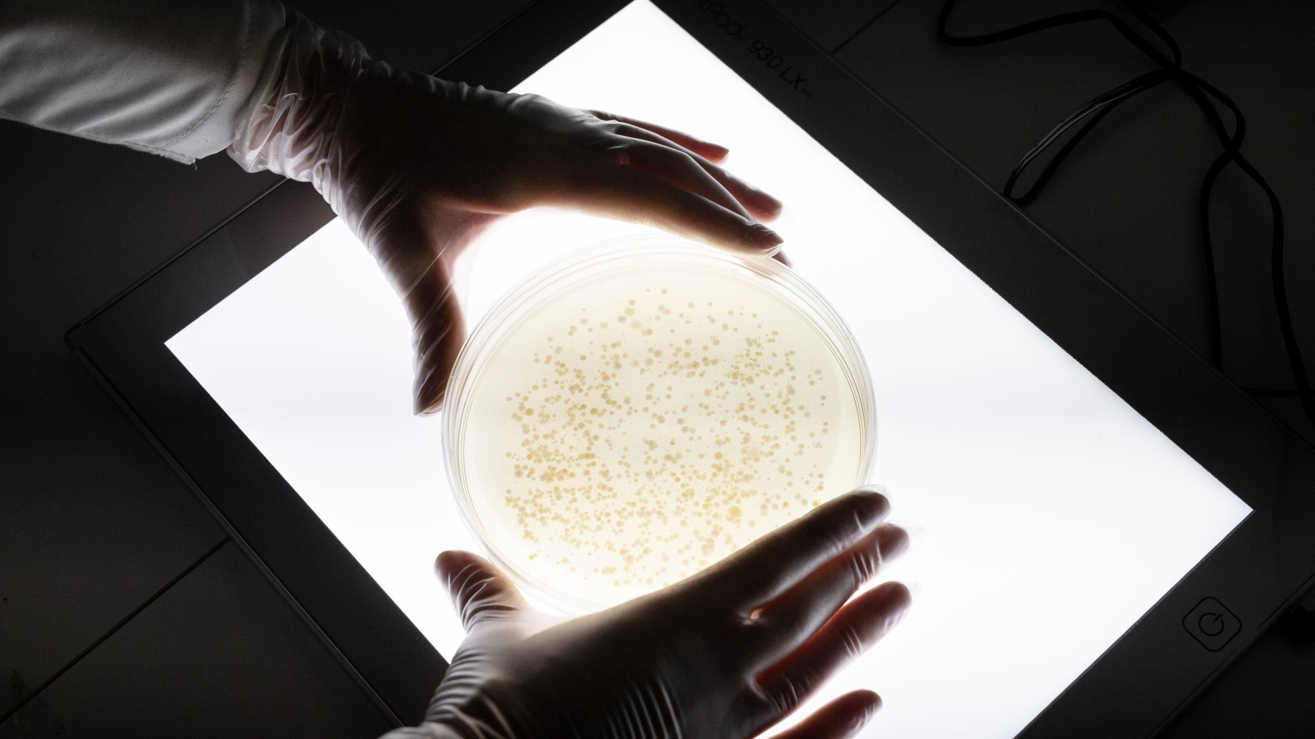
research & innovation
© Renee Altrov

Slide 12
broad, innovative and diverse
7,7
researchers
per thousand employed (2018)
excellent conditions
for carrying out research projects
2x growth
in the number of international researchers employed in Estonia since 2010
Notes:
Estonia has a broad, innovative and diverse research landscape. Research is primarly carried out by universities, other public and private sector education and research institutions.
Estonian science is internationally competitive and forward-looking. General publishing activity has improved (already in 2016 accomplished the published science articles target (1600) set for 2020 by publishing 1659 high quality science articles per mln people) as well as the proportion of high-level, highly cited articles. There is more and more international cooperation.

Slide 13
increasingly attractive for foreign researchers
foreign researchers
11%
Researchers in Estonia 2019
Notes:
Estonia is becoming more and more attractive to foreign researchers. The number of foreign researchers in Estonian public research institutions has been continiously increasing: in 2019, 562 foreign researchers were employed in Estonia, making almost 11% (10,85 per cent) of the total number of scientists and engineers (Statistics Estonia).

Slide 14
International researchers employed in Estonia
Notes:
The proportion of foreign researchers among all researchers working in Estonia has increased from 6,3% in 2012 to 10,9% in 2019. The facilitating factor is the modern buildings and laboratories of universities and research institutions, which create internationally attractive conditions for research.

Slide 15
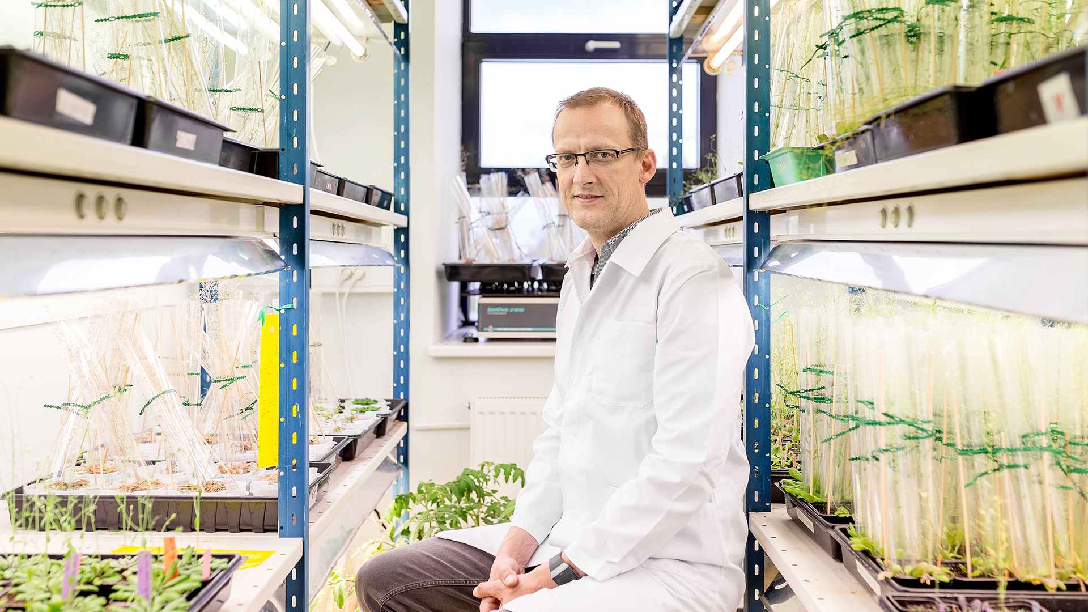
3755 researchers per million
© Renee Altrov
Notes:
In 2018, number of researchers in R&D for Estonia was 3,755.3 per million people. Number of researchers in R&D of Estonia increased from 2,138.5 per million people in 1999 to 3,755.3 per million people in 2018 growing at an average annual rate of 3.21%.
What is number of researchers in R&D?
Researchers in R&D are professionals engaged in the conception or creation of new knowledge, products, processes, methods, or systems and in the management of the projects concerned. Postgraduate PhD students (ISCED97 level 6) engaged in R&D are included.
Learn more: https://knoema.com/atlas/Estonia/Number-of-researchers-in-RandD

Slide 16
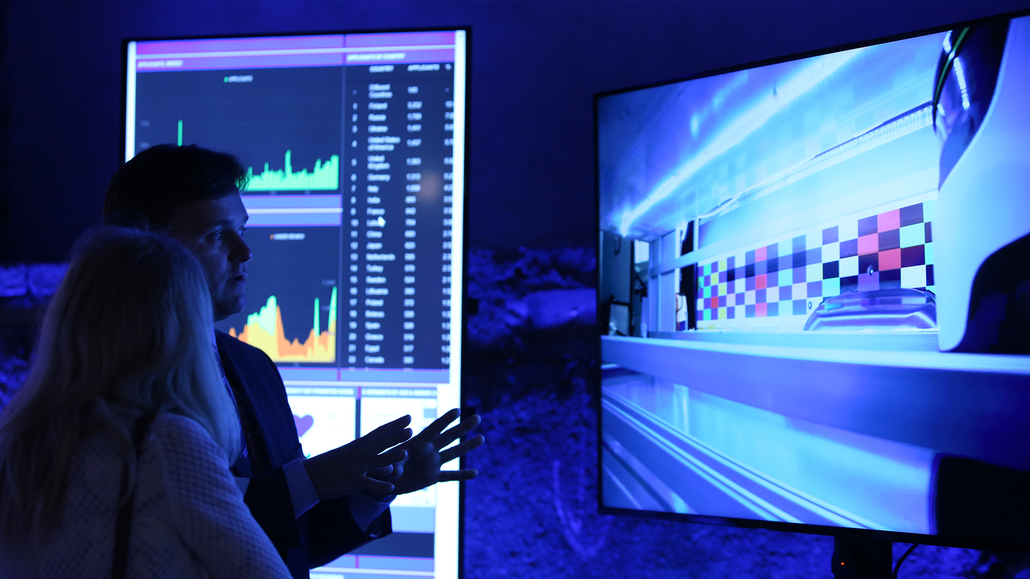
science for business
© Annika Haas
Notes:
Solutions for global problems are sought through the development of science and technology and they are applied ever increasingly in cooperation between the public and private sectors.
Examples:
Starship Technologies in cooperation with Tallinn University of Technology develops a package delivery robot, which has been tested in more than hundred cities all over the world.
In collaboration with Tallinn University of Technology and Silberauto, autonomous vehicle called ‘Iseauto’ was build.
Tallinn University of Technology with Skeleton Technologies and University of Tartu are developing ultracapacitors with special durability properties. The project is supported by the European Space Agency (ESA).
A scanner using natural radiation is being developed in a cooperation between University of Tartu and a start-up company GScan. The aim of the scanner is to make travelling, and being in public spaces in general, safer.

Slide 17
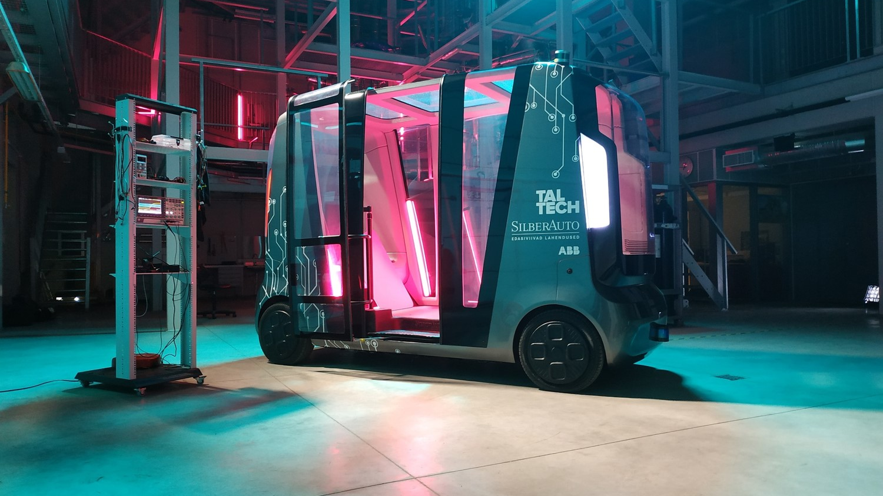
IseAuto
© Tallinn University of Technology
Notes:
The original version of this vehicle was created with only 400,000 euros for the 100th birthday of Tallinn University of Technology (Taltech). Around 20 students and university researchers were given one year to make it happen.
It is a unique and innovative autonomous vehicle that can operate in winter conditions. Other than the maximum speed of 30 km/h, the bus named Iseauto doesn’t differ much from the other vehicles in Tallinn, the capital of Estonia. Officially, it is now part of Estonian public transportation. Anyone can hop on and ride for free, because public transportation in Tallinn is free of charge for locals.

Slide 18
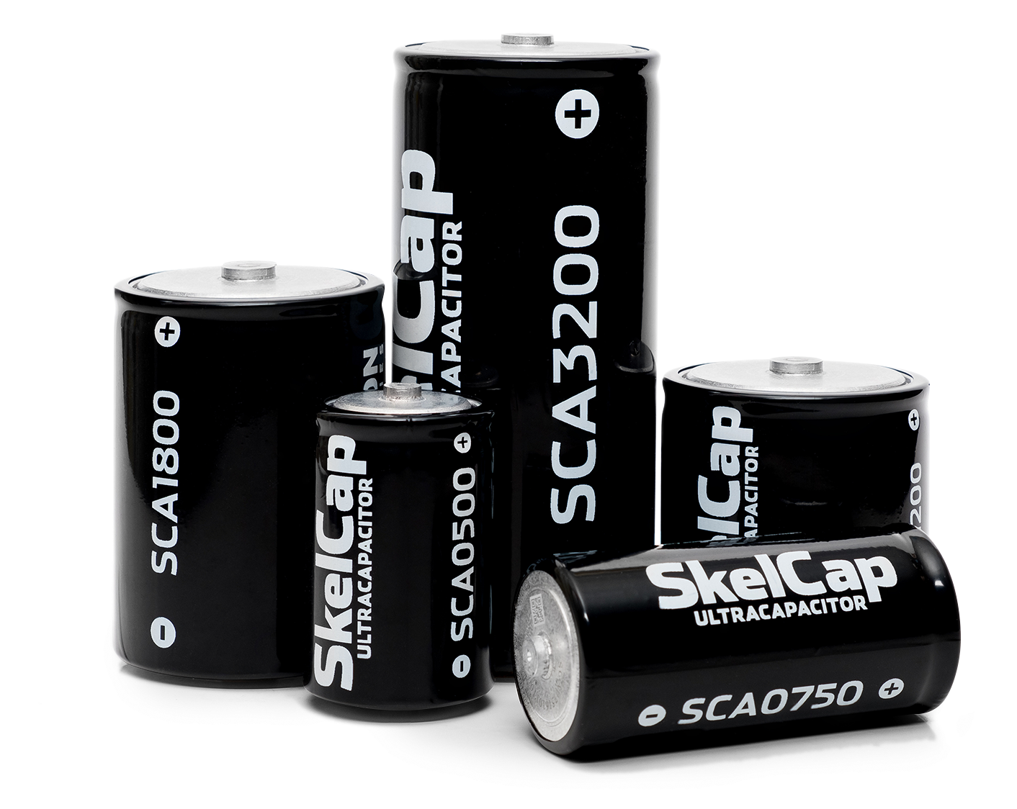
Skeleton Technologies
© Skeleton Technologies
Notes:
Global Cleantech 100 club member and European Space Agency's supplier Skeleton Technologies is European market leader in ultracapacitor-based energy storage that was created by University of Tartu scientists.
Skeleton Technologies' battery can be charged in just 15 seconds, and can go through hundreds of thousands of recharge cycles.
Skeleton’s graphene-based battery is hoping to help bridge the gap where lithium-ion batteries or hydrogen fuel cells are still not quite meeting energy requirements.

Slide 19
scientific publications and citations
Notes:
The high quality of Estonian research and researchers is also visible in research output.
According to Clarivate (2020) influential Estonian researchers among the world’s TOP 1% are:
Research Fellow in Biological Informatics, Kessy Abarenkov (cross-field)
Professor of Environmental Physics, Heikki Junninen (geosciences)
Professor of Mycology, Urmas Kõljalg (plant and animal science)
Senior Researcher of Plant Ecology, Mari Moora (cross-field)
Professor of Plant Ecology, Martin Zobel (cross-field)
Research Professor in Mycorrhizal Studies, Leho Tedersoo (plant and animal science)
Research Fellow in Mycology, Mohammad Bahram (cross-field)
Professor of Crop Science and Plant Biology, Ülo Niinemets (plant and animal science)
Professor in Molecular Ecology, Maarja Öpik
Adjunct Professor of Marketing, Linda Hollebeek
The list ranks the influence of researchers based on how much their research has been used by other researchers, i.e., the number of citations.

Slide 20










10 most cited fields
Source: WoS (InCites) in 2010-2020.
clinical
medicine
biology and biochemistry
plant and animal science
pharmacology and toxicology
environmental sciences and ecology
2.
4.
6.
8.
10.
1.
3.
5.
7.
9.
molecular biology and genetics
physics
space science
microbiology
psychology and psychiatry
Notes:
The most cited fields (compared to global average of the field) according to WoS are clinical medicine; molecular biology and genetics; biology and biochemistry; physics; and plant and animal sciences. Among recent notable discoveries are Estonian researchers Ülo Niinemets, who found that stressed plants emit a stress response, thus helping to create clouds, while researcher Tuul Sepp studied the colour of House Finch plumage, finding that birds with poor digestion basically lose their colour.

Slide 21
#16 in the EU
Source: European Innovation Scoreboard 2020
for the
publications published in
this result
places Estonia
2010-2017
8,35%
#16
#1
Reached the
10% of the world’s most cited publications
in the EU
among EU
Member states who joined since 2004
by Estonian authors
Notes:
For the publications published in 2010-2017 by Estonian authors, 8.35% reached the 10% of the world`s most cited publications. This indicator places Estonia #16 in the EU in terms of scientific impact.

Slide 22
Research Information System (ETIS)
etis.ee
Notes:
The Estonian Research Information System concentrates information on research- and development institutions, researchers, research projects and various research results. The Estonian Research Information System is also an information channel for submitting and processing grant applications and for submitting and confirming project reports.
The Estonian Research Information System is an information channel and a tool for researchers as well as R&D institutions. Researchers can use the Estonian Research Information System as a place, where they can submit applications for grant competitions, read news and chat in the forum about research. R&D institutions can submit through the Estonian Research Information System applications and introduce their research results more widely. Several R&D institutions use ETIS also as their internal research information system. Research funding organisations use ETIS for evaluating and processing applications and giving feedback.
The Estonian Research Information System has been established by the Estonian Ministry of Education and Research and is operated by the Estonian Research Council.
Learn more: etis.ee

Slide 23
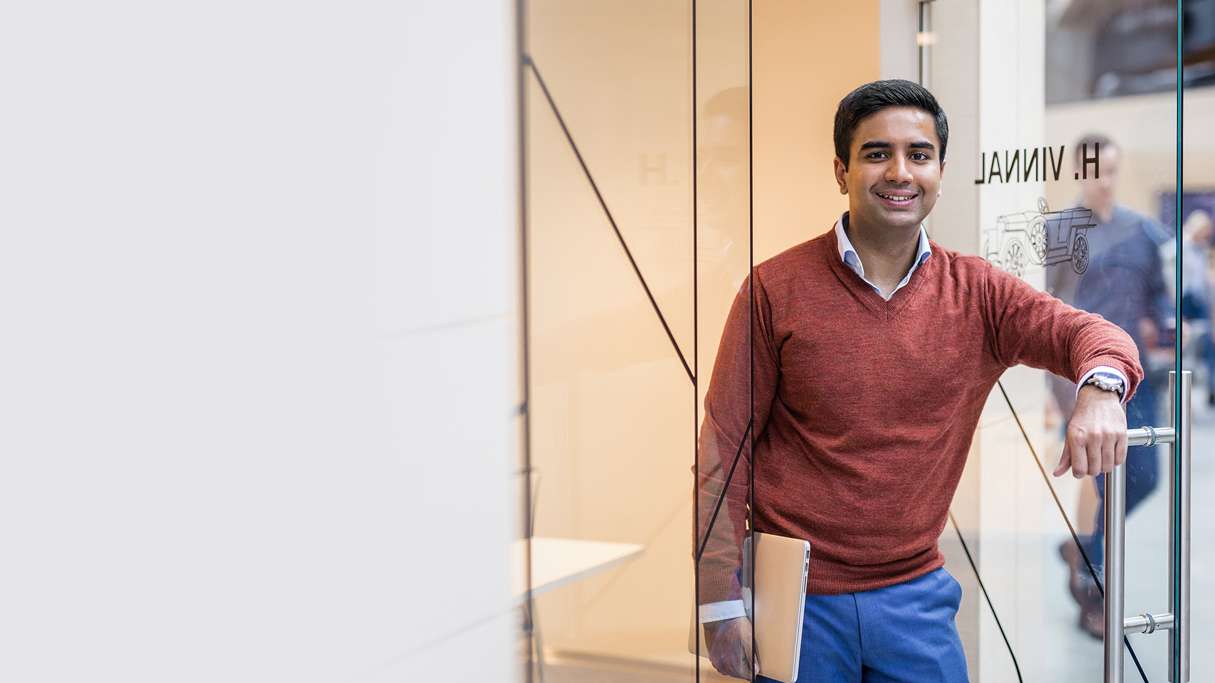
international research cooperation
© Renee Altrov
Notes:
More than 2/3 of the publications by Estonian researchers have been published in collaboration with foreign colleagues. Being highly valued partners in the international cooperation projects when theory goes to practice they are actively participating in European Organization for Nuclear Research (CERN), European Space Agency, European Social Survey, European Spallation Source and other various science and R&D projects.
Being highly valued partners in the international cooperation projects, in 2021 Estonia became an Associated member of the European Organization for Nuclear Research (CERN).

Slide 24
Funding received from European programmes
6TH FRAMEWORK PROGRAMME
7TH FRAMEWORK PROGRAMME
331 projects
33 374 579 €
466 projects
96 250 985 €
H2020 PROGRAMME
638 projects
241 143 366 €
Notes:
The 6th Framework Programme (FP6) supported the European strategy for space with ‘application-oriented’ research projects from 2002 to 2006, in collaboration with the European Space Agency (ESA). The budget allocation to FP6 for the duration of the programme was EUR 1.182 billion. During the 5-year period Estonia received 33,4M and was involved with 331 projects.
7th Framework Programme for Research, covering the period 2007 to 2013, was an opportunity for the EU to match its research policy to its ambitions in terms of economic and social policy by consolidating the European Research Area (ERA). Through the programme, Estonia received 96,3M and was involved with 466 projects.
Horizon 2020 couples research and innovation, and has an emphasis on excellent science, industrial leadership and tackling societal challenges. Between the years 2014 to 2020, 638 projects have received alltogether 241M euros through the H2020 programme (eCORDA, 2020).

Slide 25



Horizon 2020
HORIZON 2020
EXAMPLES
GDHRNet-systematically explores the theoretical and practical challenges põsed by the online context to prodect ion of human rights
SilentBorder-aims to develope nem muon scanners using natural radiation for border controls
SmartEnCity-
Towards Smart
Zero CO₂ Cities
across Europe
Notes:
Project examples developed through the H2020 programme:
SmartEnCity – Towards Smart Zero CO2 Cities across Europe, participated by City of Tartu, Estonia.
SilentBorder - aims to develope new muon scanners using natural radiation for border controls, developed by University of Tartu, GScan
The GDHRNet - systematically explores the theoretical and practical challenges posed by the online context to the protection of human rights, coordinated by Tallinn University.

Slide 26
participation in Horizon 2020
EU financial contribution for participants from a country in relation to GDP (EU28=100%)
Notes:
Estonia is holding a very good position within the EU in view of its successful participation in Horizon 2020. If we compare the proportion of the awarded funds to a country’s GDP, Estonia exceeds the European average 2.5 times. Such success is evidence of the high level and competitiveness of Estonian researchers and entrepreneurs in the European research and innovation market. Since participation in the EU Framework Programme generally requires co-operation, success also indicates that our researchers and entrepreneurs are valued partners.
Chart source: eCorda, 2021

Slide 27
funding

Slide 28
Expenditure on R&D by source of funds 2019 (mln eur)
research grants
40,6
9,0%
baseline
funding
39,1
8,6%
168,5
37,3%
other
government funding
88,9
19,6%
funds from abroad
60,2
13,3%
222,4
49,1%
0,7
0,2%
higher education sector
business enterprise sector
private non-profit sector
0,9
0,2%
Notes:
Research in Estonia is primarily financed on the basis of quality competition. Financing comes mainly from the state budget; but also form companies, foreign funds, and other EU initiatives. Estonian Research Council (ETAg) is the main body responsible for the funding of R&D, supports researchers’ mobility and external cooperation offering various segment of grants.

Slide 29
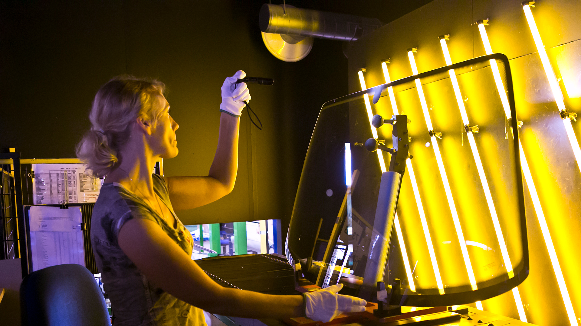
smart specialisation
© Annika Haas

Slide 30
smart specialisation
R&D funding is focused on programs that are developing:
ICT
HEALTH TECH
EFFECTIVE USE
OF RESOURCES
start-ups
cyber security
robotics
smart textiles
personal medicine
digital prescriptions
genetics research
e-Health
materials science and industry
innovative construction
healthy and functional food
chemical industry
Notes:
Whereas in science publication Estonia makes waves in environmental and natural sciences, the main focus of local RDI strategy is to boost the growth of three sectors: ICT horizontally through all sectors, health technologies and services, and effective use of resources.
IT sits at the core of how Estonia runs ― and portrays ― itself. From cybersecurity to biomimetic robots and smart textiles Estonian research has a lot to offer.
Estonia with its e-Health programme (incorporating Electronic Health Records, Digital Image, eAmbulance, e-Prescriptions etc) and Biobank stands out for its ongoing ambitions to develop and implement personal healthcare.
Effective use of resources focuses on materials science and industry, innovative construction (“smart house”), health promoting and functional food, and chemical industry (more effective use of oil shale).

Slide 31
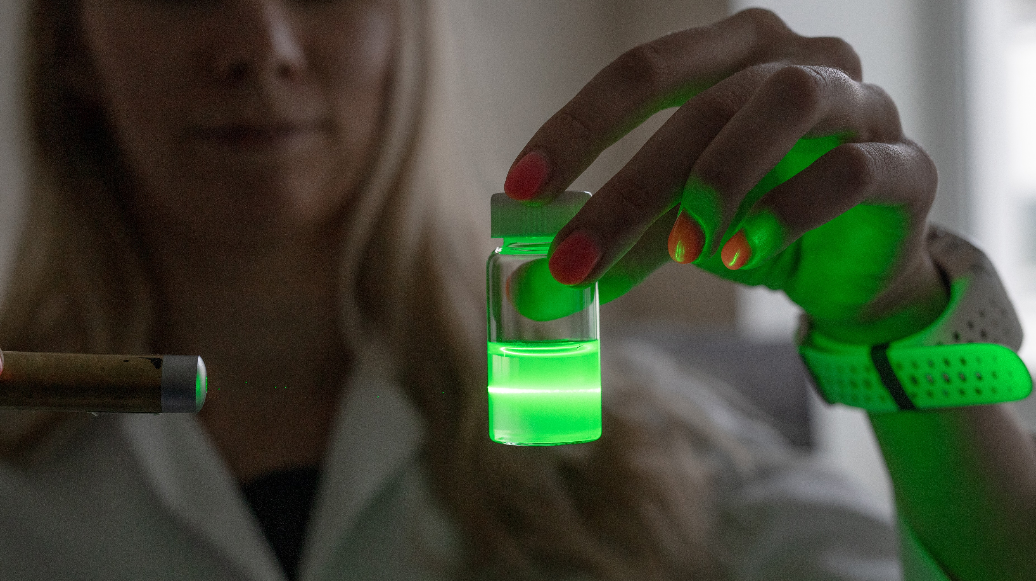
estonian science barometer
© Renee Altrov
Notes:
The Estonian Science Barometer (ESB) has been created to monitor the attitude towards science and research and the contact the Estonian population has with it.

Slide 32

estonian science barometer
66%
78%
89%
90%
87%
85%
interested
in science
trust
scientists and
researchers
sees
scientists and
researchers as
experts
agree that
science needs
to be financed
agrees that
state needs
to support research more
agrees that politicians need
to take scientists expertise
Source: Estonian Science Barometer, 2020
Notes:
The first wave of the data collection reveals that the Estonian population is interested in science (66% are interested) and generally trust scientists and researchers (78% tend to trust). Particularly high is interest in science among male respondents younger than 65 years who have an university degree. The Estonian population sees scientists and researchers as experts (89% agree) – the respective evaluation is higher than e.g. in Germany. The Estonian respondents appreciate the work the researchers and scientists do and even 90% agree that science need to be financed even if the results cannot be used for their immediate practical benefits. The state needs to support research more (do agree 87%) and politicians need to take the expertise by scientists into account in their decisions (do agree 85%). There are general expectations that science needs to be communicated more in the public sphere.
Source: Estonian Science Barometer, 2020

Slide 33

thank you!
© Virgo Haan
Notes:
The presentation is conducted by Reseach in Estonia, hosted by Estonian Research Council.
E-mail: research@estonia.eu
Website: researchinestonia.eu
Last update: April 2021

